Slide 1
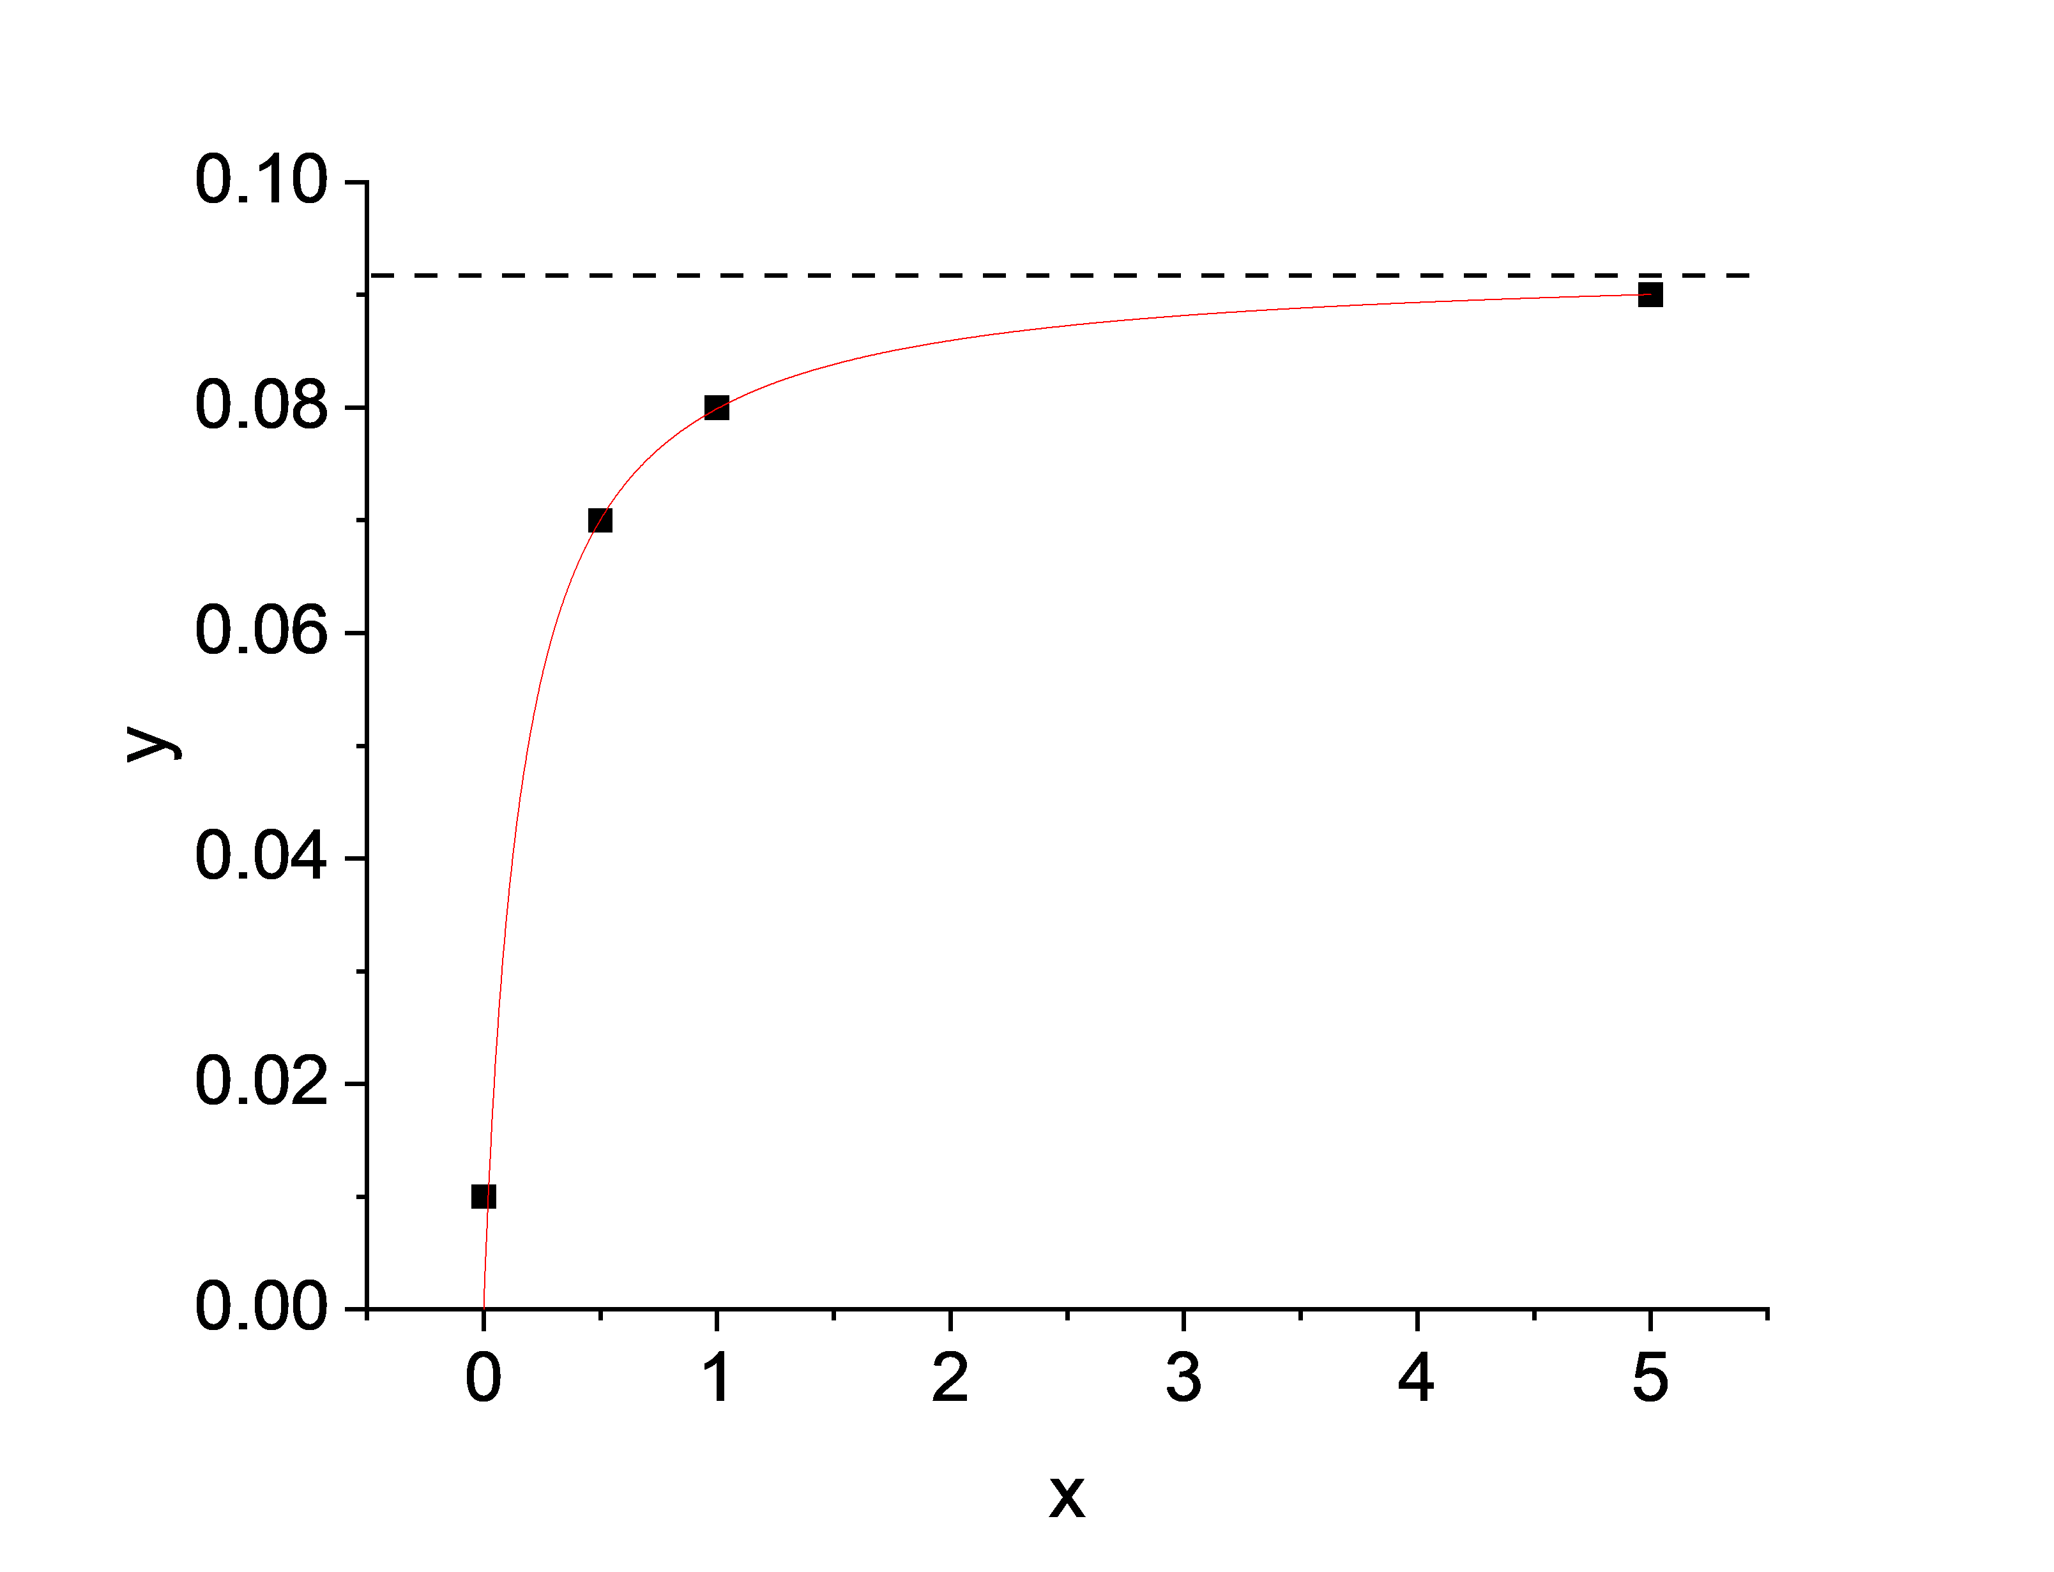
General 2nd order differential equation
Michaelis-Menten kinetics
FE-EPR (this paper)
$$Y_{sat}$$
$$P_{sat}$$
$$κ_{cat}$$
$$K$$
$$K_{m}$$
$$K_{m}$$
TEMPO⁺
TEMPO●
Catalyst/Enzyme
Substrate (S) Product (P)
Alcohol (A) Aldehyde (P)
Solutions:
$$y=\frac{Y_{sat}∙x}{K+x}$$
$$ν=\frac{P_{sat}∙S}{K_{m}+S}$$
$$κ=\frac{κ_{cat}∙A}{K_{m}+A}$$
$Y_{sat}$: asymptotic value of y when increasing x.
$P_{sat}$: limiting rate of enzyme catalysis when saturated with A.
$k_{cat}$: catalytic rate
Notes:
Figure S19

