Slide 1
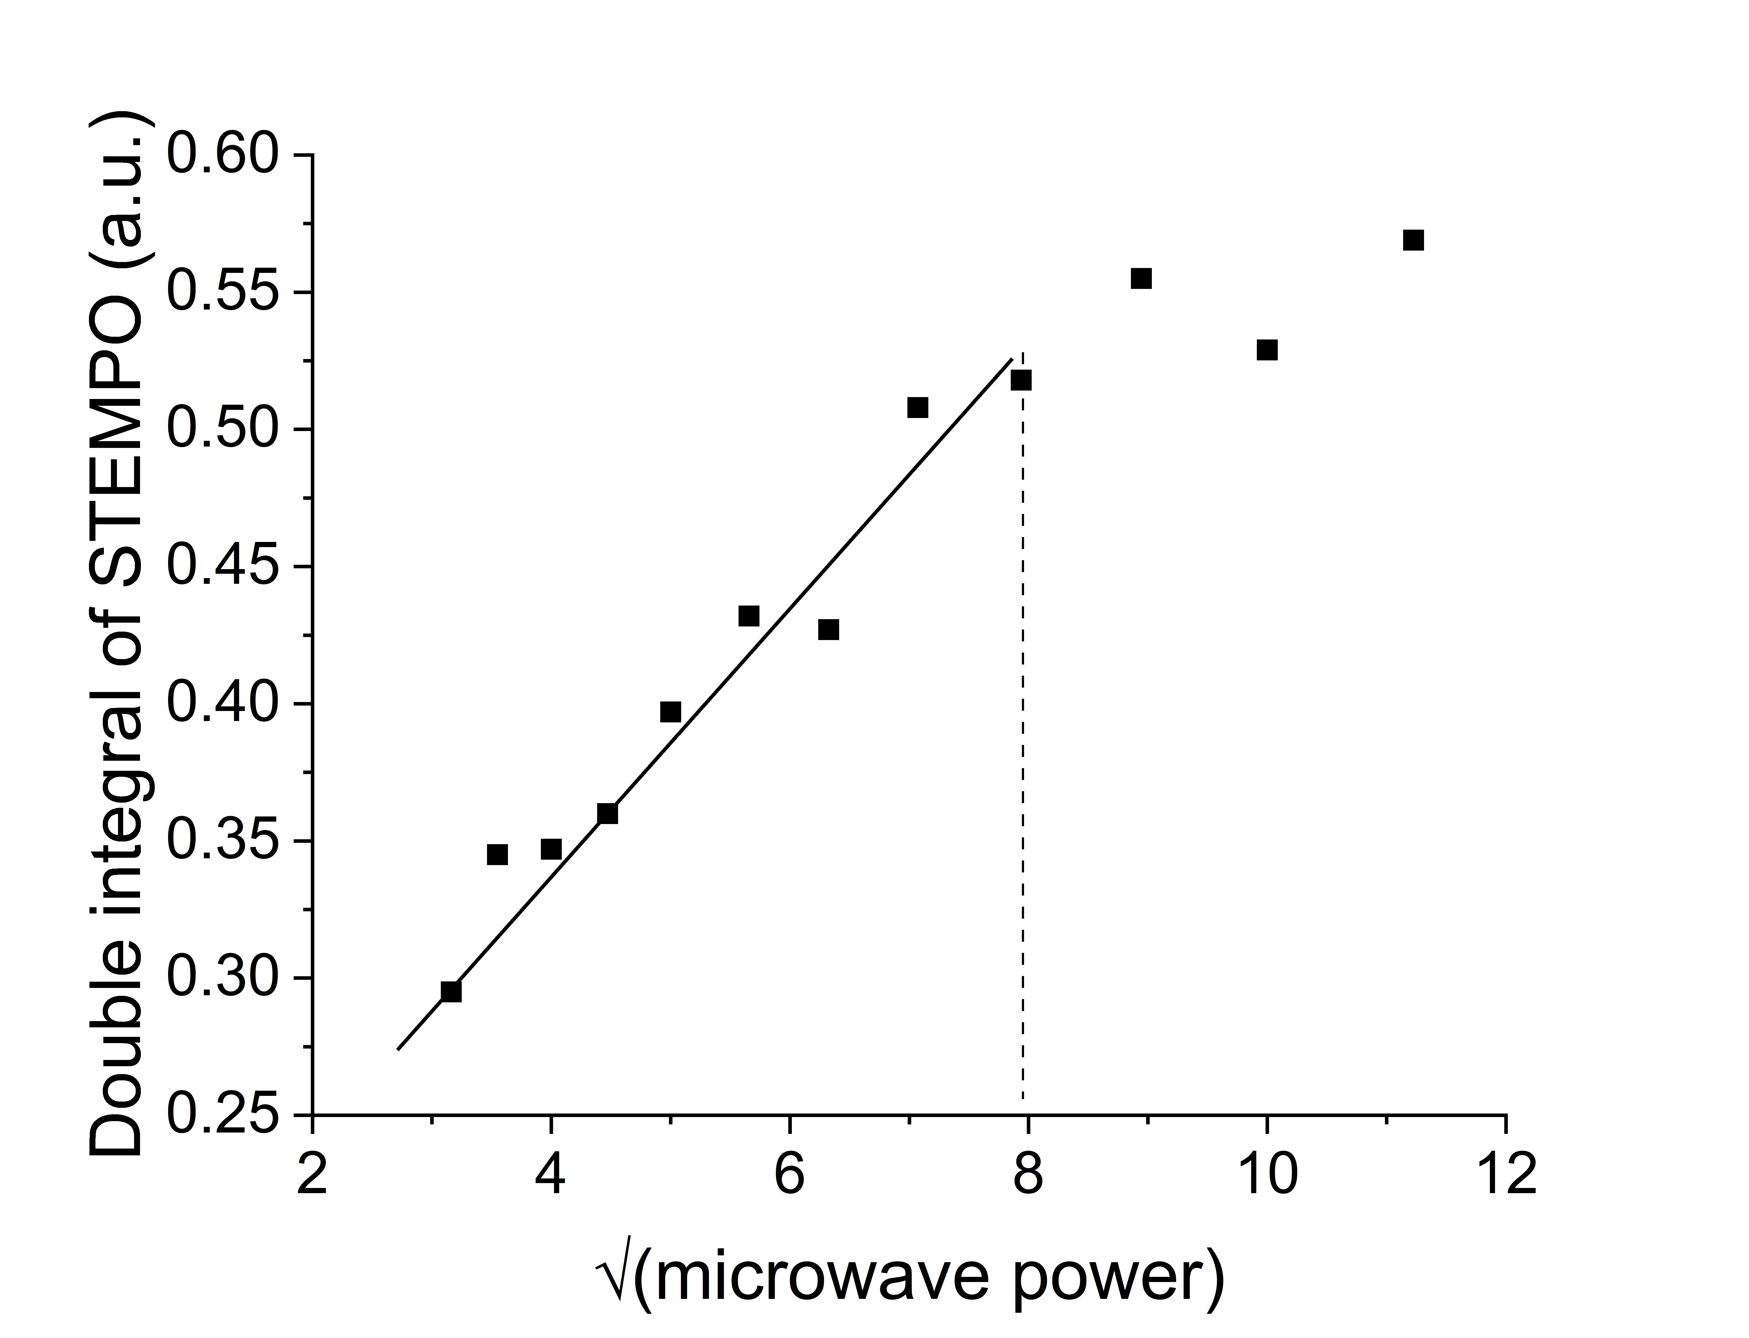
Notes:
Figure S8. Microwave saturation curve of nitroxide radical in FE-EPR cell measured in SHQE cavity at room temperature showing non-saturating (grey) and saturating (pink) regions.

