Slide 1
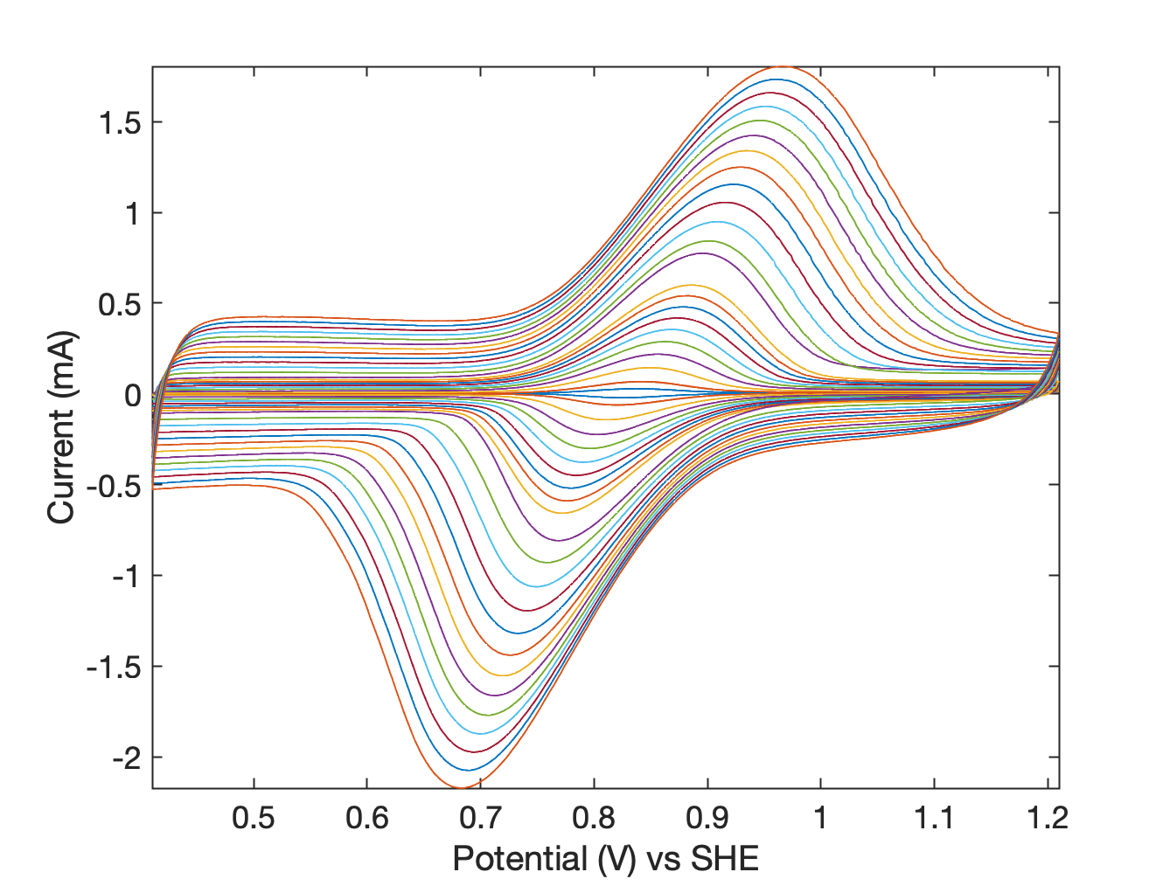
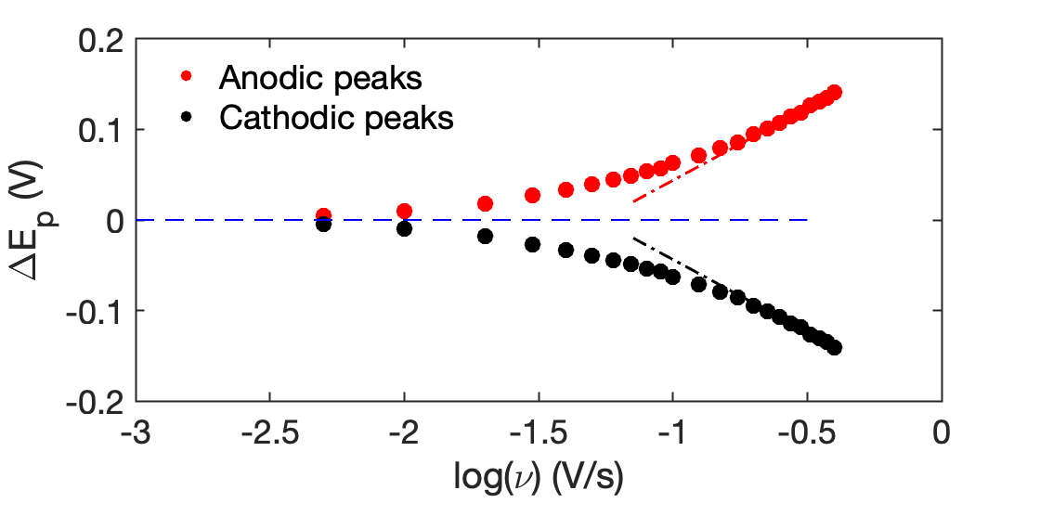
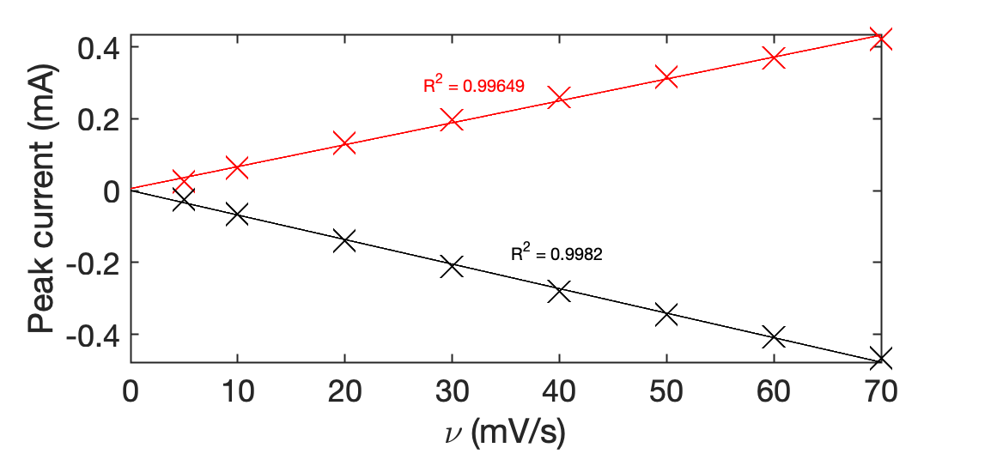
Figure S4
a
b
c
Notes:
Figure S3. Electrochemical characterization of the Ti|ITO electrode. A) Cyclic voltammograms showing oxidoreduction of STEMPO•/STEMPO⁺ recorded at different scan rates from 400 mV/s to 5 mV/s. B) Trumpet plot deduced from the variable scan rates CV measurements. C) i_{p} vs v plot for v < v_{c}. Measurements are performed in a standard glass electrochemical cell using Ag/AgCl as reference electrode, nickel wire as counter electrode and an aqueous solution of 500 mM Na₂CO₃, pH 8.0 at 20ºC.

